Slide 1
Genomic architecture of inflammatory proteins
https://github.com/jinghuazhao/INF
On behalf of the SCALLOP/INF1 consortium
2/5/2019

Slide 2
Introduction
The vital role of inflammation is well-established in immune response and increasingly recognised in a range of pathological processes and diseases.
The Olink/inflammation proteins combined with genomic data offer great opportunities to investigate the underlying biology. We therefore conducted genomewide association meta-analysis on Olink/Inflammation proteins from 12 studies within the SCALLOP consortium.

Slide 3
Study information
Name | Website | Design | N | Institution
NSPHS | www.ncbi.nlm.nih.gov/pubmed/20568910 | population study Sweden | 866 | Uppsala
Pfizer.trials | www.pfizer.com | rheumatoid | 185 | Pfizer
STABILITY | https://clinicaltrials.gov/ct2/show/NCT00799903 | atherosclerosis | 2951 | Uppsala
STANLEY swe6 | www.ki.se/meb/stanleyswebic-studien | bipolar, depression | 300 | Karolinska
STANLEY lah1 | www.ki.se/meb/stanleyswebic-studien | bipolar, depression | 344 | Karolinska
BioFinder | http://biofinder.se | dementia | 1496 | Karolinska
COMBINE.RECOMBINE | www.combinesweden.se/ | rheumatoid | 860 | Karolinska
Estonian Biobank | www.geenivaramu.ee/en/access-biobank | population study Estonia | 487 | Tartu
INTERVAL | www.intervalstudy.org.uk/ | blood donors England | 4902 | Cambridge
KORA F4 | https://www.ncbi.nlm.nih.gov/pubmed/16032513/ | population study Germany | 1064 | Helmholz
ORCADES | https://www.ed.ac.uk/usher/molecular-epidemiology/our-studies/the-orkney-complex-disease-study | population isolate Orkney | 981 | Edinburgh
VIS | https://www.ed.ac.uk/usher/molecular-epidemiology/our-studies/croatian-studies | population isolate Croatia | 899 | Edinburgh
Total |  |  | 15335

Slide 4
Study design
Genotypes. 1000Genomes, HRC or UK10K+1000Genomes imputed genotypes.
Proteins. inverse normal transformed Olink/inflammation.
Model. Additive genetic model with adjustment for sex, age, principal components and/or cohort-specific covariates.
Meta-analysis. Per-SNP meta-analysis on effect sizes through METAL.
Independent signals. PLINK clumping and joint/conditional analysis with GCTA.
1000Genomes and individual level genotype data from INTERVAL were used as LD reference panels.
Approximately independent LD blocks.
Bonferroni correction on genomewide significance 5e-8/92.

Slide 5
Association analysis for KORA
Pilot with success/failure with BOLT-LMM on OPG/TNFSF14
Switch to SNPTEST on transformed measurement ~ age+sex+PC1-PC5
Exclusion of six related individuals
INFO score was compared between SNPTEST and qctool –snp-stats
Final sample size N=1,064
Several disruptions on cardio/TRYGGVE and FGF.5 for #SNPs

Slide 6
Details for METAL
TACKPOSITIONS/CUSTOMVARIABLE with 2018-08-28 release.
~ 36hr on TRYGGVE.
No GC correction (polygenicity/population stratification) on individual studies.
Effect size-based (could be compared with p/N counterpart).
N>=10.

Slide 7
Quality control of meta-analysis
QCGWAS only desirable for small (esp. problematic) number of proteins.
Manhattan plots were produced for each protein from each cohort.
It indicates that sumstats are generally satisfactory.

Slide 8

Manhattan plots

Slide 9

Q-Q plot

Slide 10

Busy example of IFN.gamma ylim=c(0,25)

Slide 11
Near-independent signals
1KG (LocusZoom 1.4, cardio), and UK10K+1KG as LD references, with (experimentally) balanced and comparable parameters, i.e.,
PLINK --clump-r2 0.1 can also give overlap with approximately independent LD bocks (see INF1.UK10K+1KG.AILD.r2-0.1.ranges).
GCTA --cojo-collinear 0.9 gives near-independent (primary + secondary) signals..
INTERVAL and INF1 share similarity in both number of signals and cis/trans classification, while UK10K+1KG reference panel gave more signals than 1KG.

Slide 12
Associate information on LLOD
An attempt was made by using llod/2.
Busy Manhattan plots were largely related to this.
Although higher MAF cutoff could do away with busy (excessive number of significant hits) Manhattan plots, the associate proteins with low >LLOD% were discarded.

Slide 13
Busy Manhattan plots and % (above LLOD)
Protein | % | Protein (continued) | % (continued)
L.15RA | 0.841 | IL13 | 0.062
ST1A1 | 0.808 | IL.20RA | 0.057
MCP.3 | 0.804 | IL.24 | 0.051
FGF.5 | 0.652 | IL.20 | 0.046
AXIN1 | 0.425 | NRTN | 0.039
IL.17A | 0.380 | ARTN | 0.035
IL.17C | 0.369 | IL.1.alpha | 0.025
IL4 | 0.171 | IL.2RB | 0.023
IL5 | 0.162 | IL33 | 0.014
IL.10RA | 0.149 | IFN.gamma | 0.007
TNF | 0.096 | TSLP | 0.005
LIF | 0.064 | IL.22.RA1 | 0.003

Slide 14
Results
Manhattan, Q-Q, LocusZoom (rsid instead of SNPID)/forest (right allele labelling/effect size).
Identification of near-independent signals with 1KG (built from LocusZoom 1.4 and also curated databases at cardio), UK10K+1KG (INTERVAL genotypes) and contrast with INTERVAL.
Finemapping, LDSC analysis, pathway analysis?
Quantitative trait/disease outcomes, e.g., CVD, lung function.

Slide 15

IFN.gamma from >1,000 signals to none

Slide 16

OPG Manhattan plot

Slide 17

OPG Q-Q plot

Slide 18

OPG regional plot (chr8)

Slide 19

OPG forest plot (chr8)

Slide 20

OPG forest plot (chr17)

Slide 21
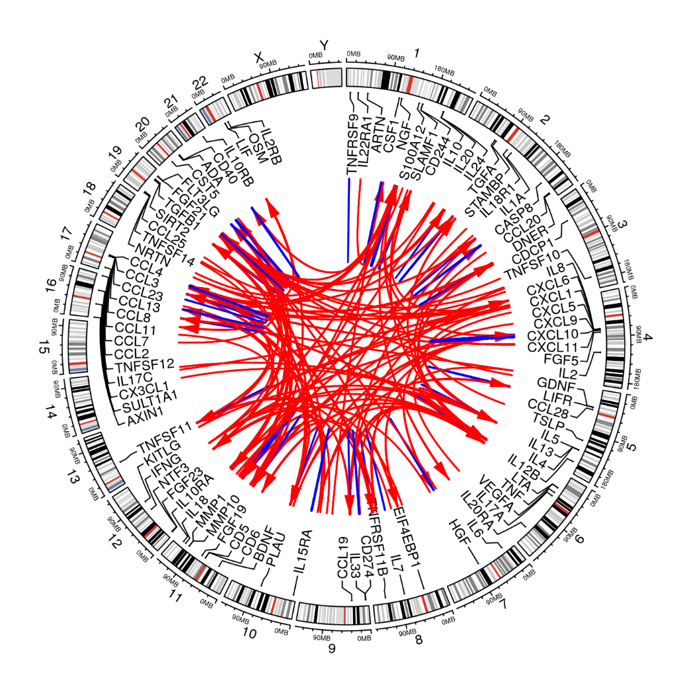
410 Signals
380 primary+30 secondary signals.
Proteins |  | Signals
only cis pQTLs |  | 13
only trans pQTLs |  | 14
both cis and trans |  | 45
no pQTL |  | 20
 |  | 92
228 cis/182 trans signals

Slide 22
Annotation through PhenoScanner

Slide 23
Conclusion
Our joint/conditional analysis took full advantage of the approximately independent LD blocks which helps to resolve the uncertainty in LD-window specification. The specific findings on OPG was just an example that we would be able to replicate earlier work by Kwan et al. (2014) on a greater scale. Our findings will corroborate with related work on broad spectrum of proteins as reported in Sun et al. (2018) as well as findings related to inflammation on the SomaScan panel used (Niewczas et al. 2019).
Work is ongoing for further downstream analysis. Further information is available from
https://github.com/jinghuazhao/INF which will also facilitate other analysis using Olink platforms.

Slide 24
Outlook of analysis
Discovery, replication – INTERVAL, meta-analysis, NSPHS.
PLINK –clump has 932/628 (~1M/~2M) pending on manual exclusion using LD.
GCTA –cojo analysis on 1KG reference produced 359 near-independent (~1M interval, 305 primary + 54 secondary) signals (~10 days on cardio and 62 proteins so far with UK10K+1KG panel), which is preferably intersected with approximately independent LD blocks for finemapping – very much as a further research topic.
Effect size/MAF plot.
Power/winner’s curse/bivariate LDSC – plots/correlation of effect size and/or pQTLs from INTERVAL vs INF1.
Additional information on genotyping and cohort characteristics needs to be requested for the paper.
Elementary summary statistics such as h2 from INTERVAL, with KORA relatively small for GCTA and possibly with INF1 for HESS. This was examined by Kwan et al. (2014) whose results on OPG were replicated from the analysis.

Slide 25
Landmarks
27/3/19 – cross-reference with INTERVAL on INTERVAL genotype data, which showed great similarity with INF1, esp. w.r.t. cis signals.
8/3/19 – Recognition of MAF cutoff on IFN.gamma, IL.22.RA1, TSLP.
29/11/18 – 22 proteins with busy Manhattan plots.

Slide 26
On next steps (29/11/18)
KORA individual level data analysis will be conducted centrally.
Additional studies such as COMBINE will be added.
For cohorts contributing results on PLINK, information such as effect allele (frequency), imputation quality is recommended on a per-cohort basis via qctool as noted in SCALLOP_INF_I_analysis_plan.md.
The QC will be refined and downstream analysis strengthened -- the experiments were based on 1000Genomes extracted from LocusZoom 1.4 at tryggve when there was issues with the up-/down-load. A more desirable reference panel would be INTERVAL, UKBiobank, both involving HRC+UK10K. Finemapping is set to involve PLINK, GCTA, finemap, and JAM, among others.

Slide 27
Points from discussion (8/3/19)
Cohort-specific sumstats for N, MAF, HWE, INFO in qctool –snp-stats
sumstats/Mantattan for cohorts with problematic proteins
Between-cohort MAF-MAF plots
P ~ N (for finemapping) and consistency, e.g. INTERVAL/STABILITY.
False negative for those in the CVD1 panel to phenoscanner
Chr19. NLRP12 from INTERVAL`
RECOMBINE experiment
Total # signals relative to other panels
Phenoscanner and eQTL

